Slide 1

What’s New In NIEM 6.0?
22 May 2025
Dr. Scott Renner, PhD.
NTAC Co-Chair, NIEMOpen

Slide 2
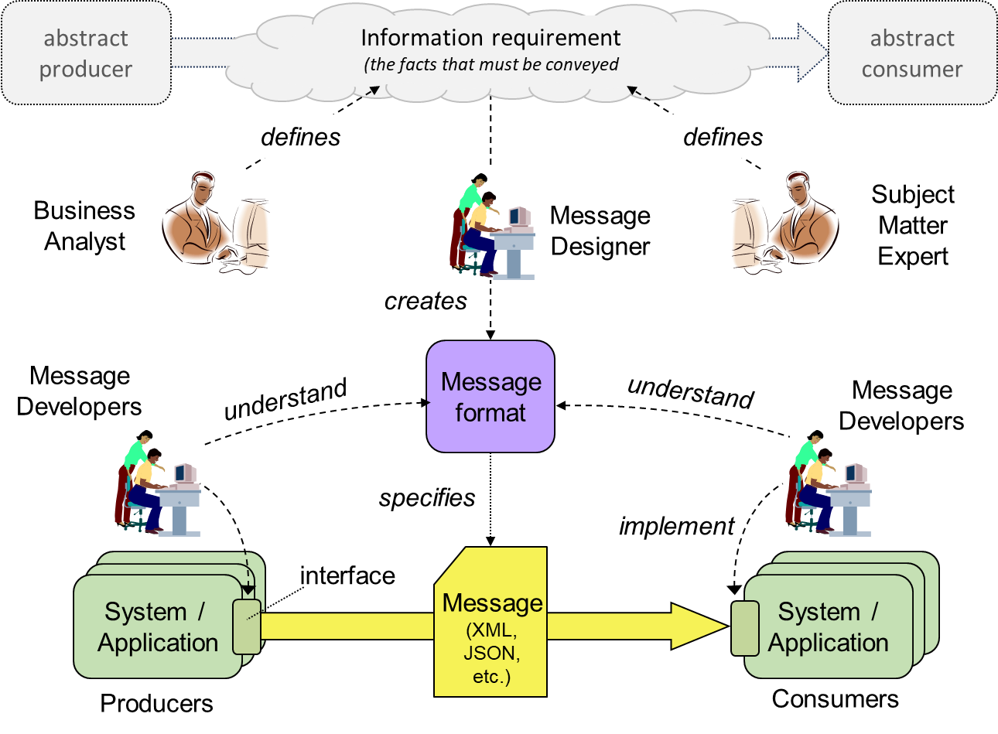
Purpose Of NIEM
A standard for data specifications
A reusable community-agreed data model
A tradeoff between
N² pairwise arrangements
Single model
Works for
File transfer or message bus
APIs
Web resources
Widely useful for machine-to-machine data sharing
Notes:
The purpose of NIEM is to help developers write software that correctly exchanges data at runtime.
NIEM provides a standard way to specify that exchanged data, which helps developers to understand what their code should expect or must produce.
NIEM also provides a community-agreed, reusable data model that is a starting point for those data specifications.
The result is a tradeoff between pairwise sharing arrangements – which you can't afford, there are too many pairs – and one single data model of everything for everybody – which is not feasible at any large scale.
BTW, we describe the shared data as a message, which makes people think of file transfer or an enterprise service bus. NIEM does not care how that data is transferred from producer to consumer, and so NIEM works equally well for the data that is passed through an API, or for a resource posted on the web. It is useful for a very large category of machine-to-machine data sharing.
Now let's talk about the new features in NIEM 6.

Slide 3
NIEM 6.0: Not Your Father's NIEM...
Many new features and simplifications
First-class support for JSON messages and JSON developers
New technology-neutral data model format
Pathway to artificial intelligence – ontologies and knowledge graphs
Free and open-source developer tools
Notes:
NIEM 6.0 is a major update that adds important new capabilities, while at the same time making NIEM easier to understand and use.

Slide 4
NIEM XML == NIEM JSON
Developers can work with XML, or JSON, or both
<ex:CrashDriverInfo>
<j:Crash>
<j:CrashVehicle>
<j:CrashDriver s:id="P01">
<nc:PersonBirthDate>
<nc:Date>1890-05-04</nc:Date>
</nc:PersonBirthDate>
<nc:PersonName>
<nc:PersonGivenName>Peter</nc:PersonGiv
<nc:PersonMiddleName>Death</nc:PersonMi
<nc:PersonMiddleName>Bredon</nc:PersonM
"exch:CrashDriverInfo": {
"j:Crash": {
"j:CrashVehicle": {
"j:CrashDriver": {
"@id": "#P01",
"nc:PersonBirthDate": {
"nc:Date": "1890-05-04"
},
"nc:PersonName": {
"nc:PersonGivenName": "Peter",
"nc:PersonMiddleName": [ "Death", "Bred
NIEM-based message in XML
equivalent to
NIEM-based message in JSON
Notes:
NIEM was created in the hey-day of XML data, and for some time XML was the only thing that NIEM did. There are still plenty of people working with XML data, but JSON is now both more popular and more convenient. NIEM 6 has an exact mapping between NIEM XML and NIEM JSON, so developers can work with either or both.

Slide 5
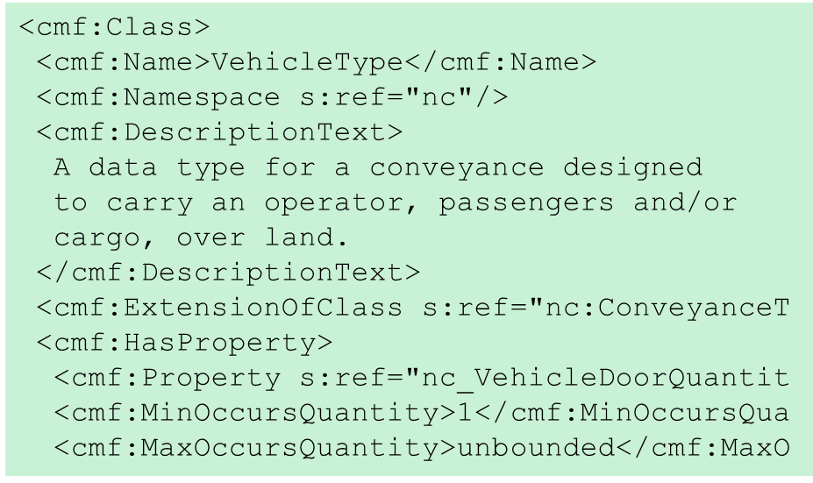
Convertible Messages
Translate messages from one format to any other – no special programming required
NIEM XML
NIEM XML
translator
any
supported
syntax
NIEM JSON
NIEM JSON
any
supported
syntax
NIEM YAML
NIEM Protobuf
NIEM-conforming message
NIEM-conforming message
message model
Notes:
In fact, XML and JSON are not the only possibilities. We will be able to support many equivalent formats: YAML, Google Protobuf, Apache Avro, perhaps others. A single translator program can convert a message between any of these. We don't need special programming for each message format, because the message model has all the information the translator needs.

Slide 6
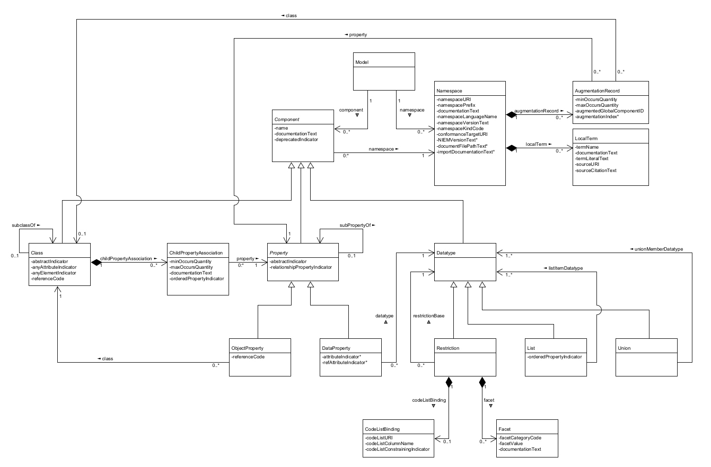
Technology-Neutral Model Format
NIEM has always used XML Schema (XSD) as its data modeling language
Model semantics formally defined via mappings to Resource Description Framework (RDF)
Convenient for designers and developers implementing XML-based data exchange
XML Schema is not convenient for JSON developers
NIEM 6 adds the NIEM metamodel and Common Model Format
Metamodel: A conceptual data model for the things we want to know about data models
CMF: A NIEM-based implementation of the metamodel
Works equally for JSON and XML
NIEM metamodel
Notes:
Those message models have always been expressed in XML Schema, which works pretty well for XML applications, but for JSON or anything else, not so good. So for NIEM 6 we developed our own model of the information that goes into a message model. The NIEM implementation of that meta-model is called the Common Model Format, or CMF.

Slide 7
Common Model Format (CMF)
Every model has an equivalent representation in XSD and CMF
<xs:complexType name="VehicleType">
<xs:annotation>
<xs:documentation>
A data type for a conveyance designed
to carry an operator, passengers and/or
cargo, over land.
</xs:documentation>
</xs:annotation>
<xs:complexContent>
<xs:extension base="nc:ConveyanceType">
<xs:sequence>
<xs:element ref="VehicleDoorQuantity"
<xs:element ref="VehicleIdentification"
<cmf:Class>
<cmf:Name>VehicleType</cmf:Name>
<cmf:Namespace s:ref="nc"/>
<cmf:DescriptionText>
A data type for a conveyance designed
to carry an operator, passengers and/or
cargo, over land.
</cmf:DescriptionText>
<cmf:ExtensionOfClass s:ref="nc:ConveyanceT
<cmf:HasProperty>
<cmf:Property s:ref="nc_VehicleDoorQuantit
<cmf:MinOccursQuantity>1</cmf:MinOccursQua
<cmf:MaxOccursQuantity>unbounded</cmf:MaxO
XML Schema like this
is equivalent to
CMF like this
Notes:
Every NIEM data model can be represented in either XML Schema or CMF. But getting the data model out of a schema document pile is hard. As a tool developer, I can tell you that CMF is a lot easier to work with.

Slide 8
CMF Supports Many Developer Technologies
CMF can be converted into developer artifacts for many technologies
<cmf:Class>
<cmf:Name>VehicleType</cmf:Name>
<cmf:Namespace s:ref="nc"/>
<cmf:DescriptionText>
A data type for a conveyance designed
to carry an operator, passengers and/or
cargo, over land.
</cmf:DescriptionText>
<cmf:ExtensionOfClass s:ref="nc:ConveyanceT
<cmf:HasProperty>
<cmf:Property s:ref="nc_VehicleDoorQuantit
<cmf:MinOccursQuantity>1</cmf:MinOccursQua
<cmf:MaxOccursQuantity>unbounded</cmf:MaxO
JSON Schema
Simplified XSD
Google Protobuf
OpenAPI
UML
Notes:
And so CMF opens the door to things we could not do before. We can generate JSON Schema for validating JSON messages. We can generate simplified XML Schema that's easier to work with. We can generate interface descriptions for other kinds of data exchange. We can generate UML diagrams to help explain data models to people.

Slide 9
Ontologies and Knowledge Graphs
Messages and models can be converted into RDF
<ex:CrashDriverInfo>
<j:Crash>
<j:CrashVehicle>
<j:CrashDriver>
<nc:RoleOfPerson s:id="P1">
<nc:PersonBirthDate>
<nc:Date>1890-05-04</nc:Date>
</nc:PersonBirthDate>
<nc:PersonName>
<nc:PersonGivenName>Peter</nc:PersonGiv
<nc:PersonMiddleName>Death</nc:PersonMi
_:n0 a j:CrashType ;
j:CrashVehicle _:n1 .
_:n1 a j:CrashVehicleType ;
j:CrashDriver _:n2 .
_:n2 a j:CrashDriverType ;
nc:RoleOfPerson _:P1 ;
_:P1 a nc:PersonType ;
nc:PersonBirthDate _:n3 ;
nc:PersonName _:n4 .
_:n3 a nc:DateType ;
nc:Date "1890-05-04" .
NIEM-based message in XML
equivalent to
NIEM-based message in RDF
Notes:
Another thing we can generate is an RDF version of NIEM models and messages. Taken together, a message plus its model forms a knowledge graph.

Slide 10
Model + Message = Knowledge Graph
NIEM
model
Location
At
Occurs
Date
Crash
Date
Crash
Involves
Involves
GivenName
Vehicle
Person
Has-A
Person
Name
Name
Has-A
Surname
ontology layer
NIEM
message
instance data layer
Is-A
_crsh17
“2022-03-04”
Involves
Involves
“Peter”
_car22
_p14
Named
_n32
Driver
“Wimsey”
Notes:
Here's a picture of the result. Knowledge graphs have applications in artificial intelligence and data fabrics and several other things. NIEM 6 can be an on-ramp for those applications. Most developers know nothing about knowledge graphs, and care even less... but if they use NIEM, their data will be usable by the people who do know and care.

Slide 11
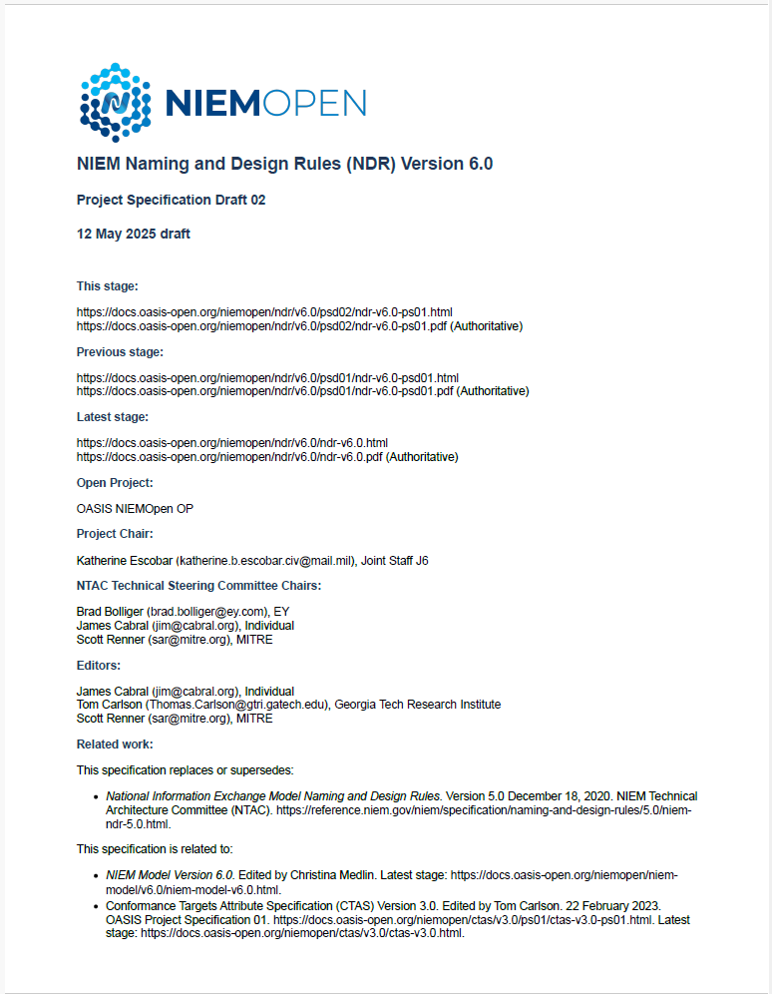
New Technical Specifications
NIEM 6 includes a complete rewrite of its key technical specification, the Naming and Design Rules
https://github.com/niemopen/niem-naming-design-rules
Notes:
We are rewriting most of NIEM's technical specifications, including the key Naming and Design Rules. You can read the current draft and even watch the sausage being made at our github repo.

Slide 12
Developer Tool Support
NIEM 6 includes new free and open-source developer tools
CMFTool
NIEM Toolbox and API 2.0
Notes:
In addition to the technical specifications, NIEMOpen is also providing free and open-source software to help message designers and message developers with their work. I'm going to give a quick demonstration of two such tools. CMFTool is a command-line swiss army knife for working with CMF models. API 2.0 is the provisioning back end for a collection of web services to support NIEM tool developers, and the NIEM Toolbox is a web front end to those services.

